Slide 1
Chapter 1
Introduction to User Centered Design

Slide 2
Introduction to User Centered Design:
Aspects of User Centered Design, Product Appreciation Assignment – Evaluating the product from user centered design aspects such as functionality, ease of use, ergonomics, aesthetics

Slide 3
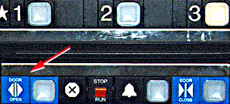
Bad designs
Elevator controls and labels on the bottom row all look the same, so it is easy to push a label by mistake instead of a control button.
People do not make same mistake for the labels and buttons on the top row. Why not?

Slide 4
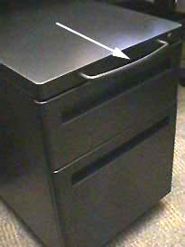
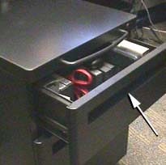
Opening the file drawer
The handle on the top doesn't open the top file drawer.
Instead, it pulls the whole file cabinet out from under the table.
The handle to move the cabinet is very close to the top drawer.
It is easy to mistake the top handle as the handle for the top drawer.

Slide 5
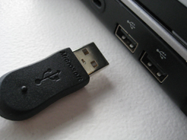
Plugging in a USB connector
Frequently turn it the wrong way.
USB symbol on "top" of the connector so if the connector is oriented horizonally, the symbol faces up.
That doesn't help if the connector needs to plug in vertically.

Slide 6
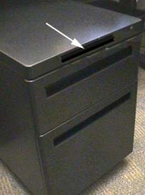
Good design
If the handle on top had been recessed like the drawer handles as shown , it wouldn't be as likely to be used accidently.

Slide 7
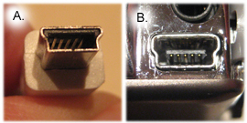
Good Design
If the connector could be inserted either way or work if it was asymmetrical, like the mini USB connector in Photo A., which plugs into B.

Slide 8
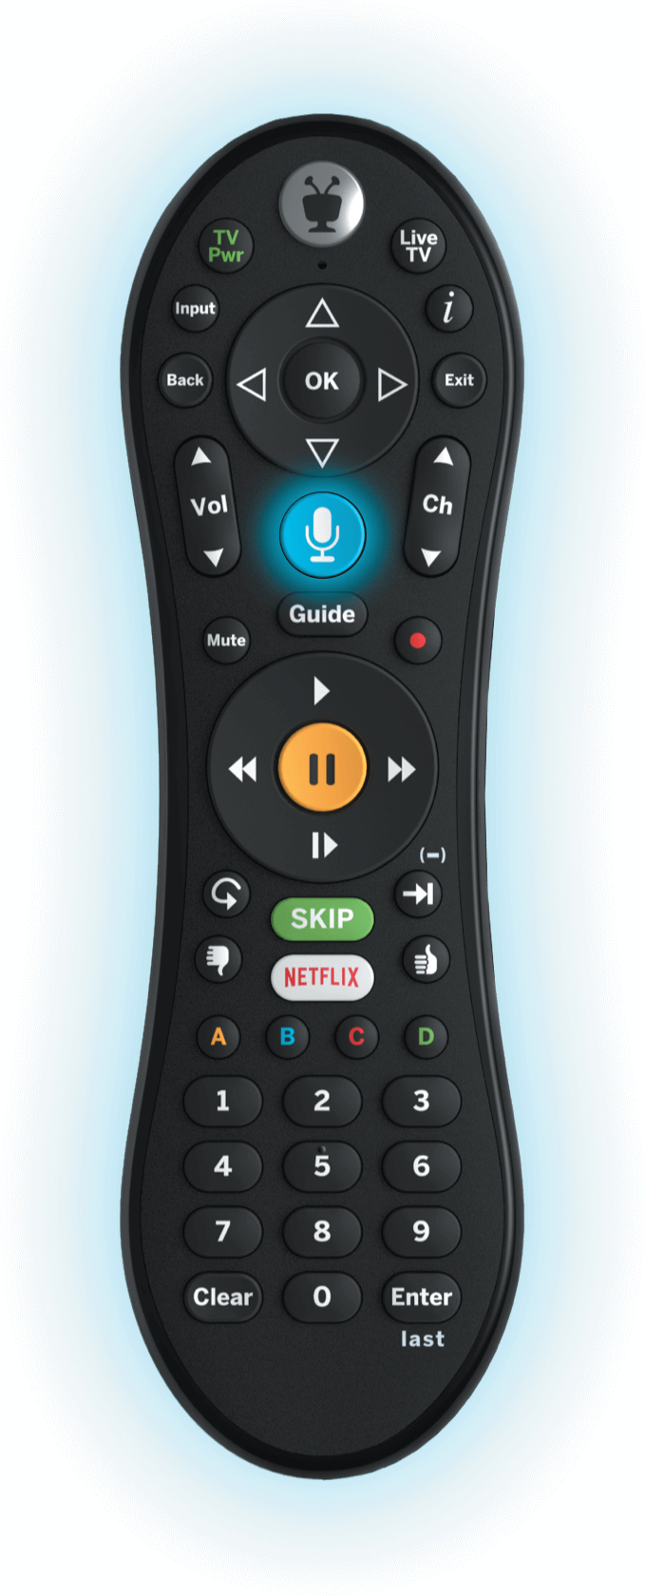
Good design
Why is the TiVo remote much better designed than standard remote controls?
Peanut shaped to fit in hand
Logical layout and color-coded, distinctive buttons
Easy-to-locate buttons

Slide 9
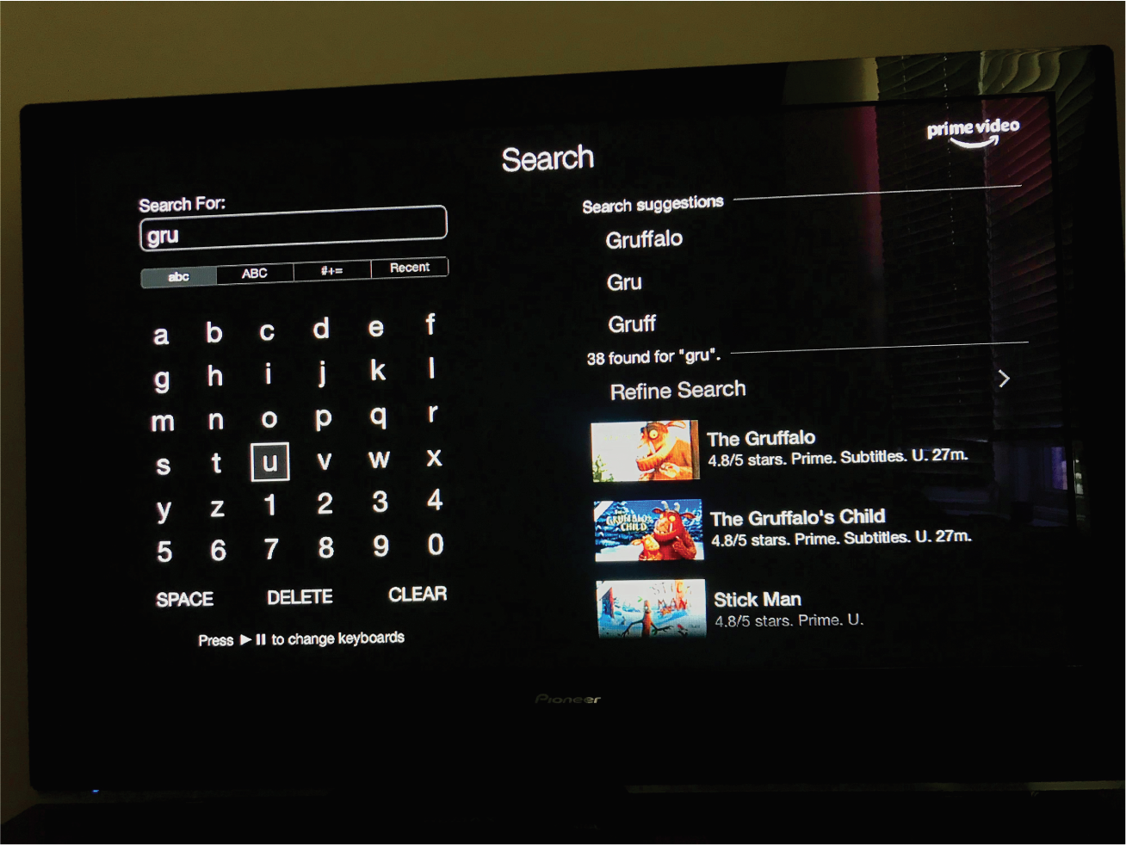
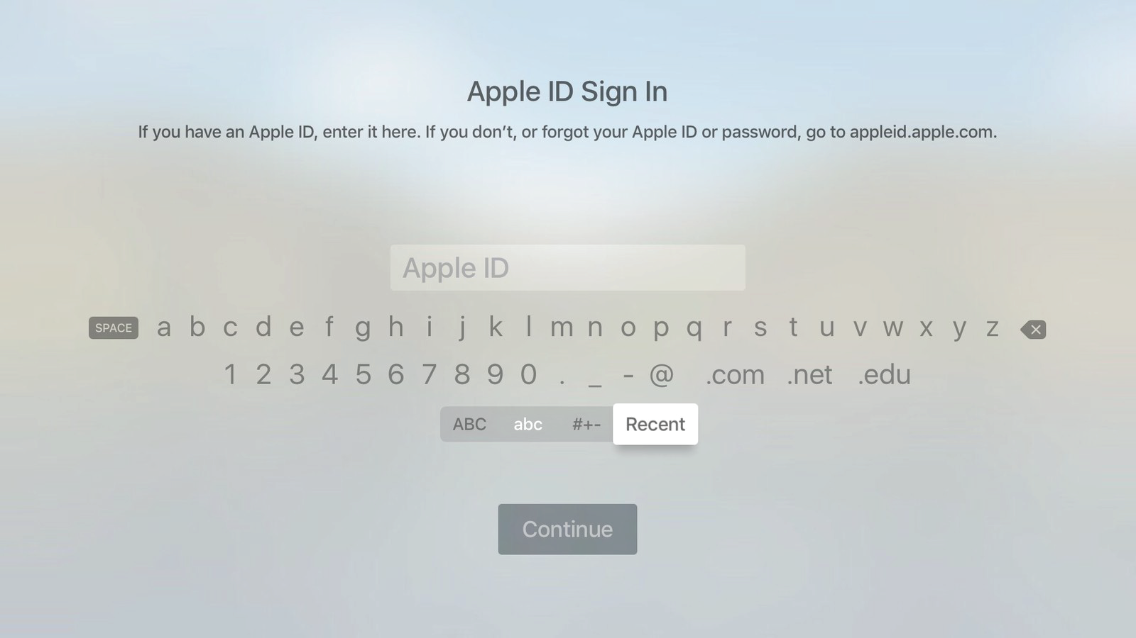
Dilemma
Which is the best way to interact with a smart TV? Why?
Pecking using a grid keyboard via a remote control
Swiping across two alphanumeric rows using a touchpad
Voice control using remote or smart speaker

Slide 10
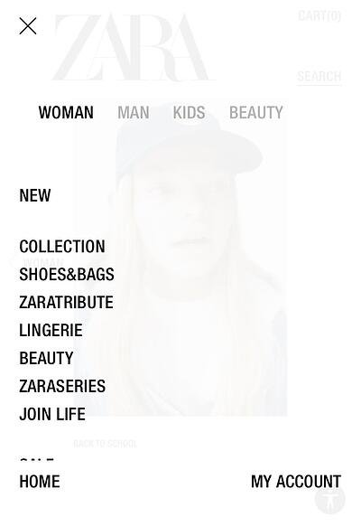
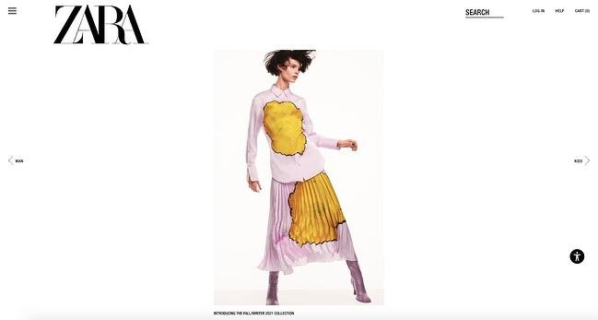
Zara- Unconventional navigation

Slide 11
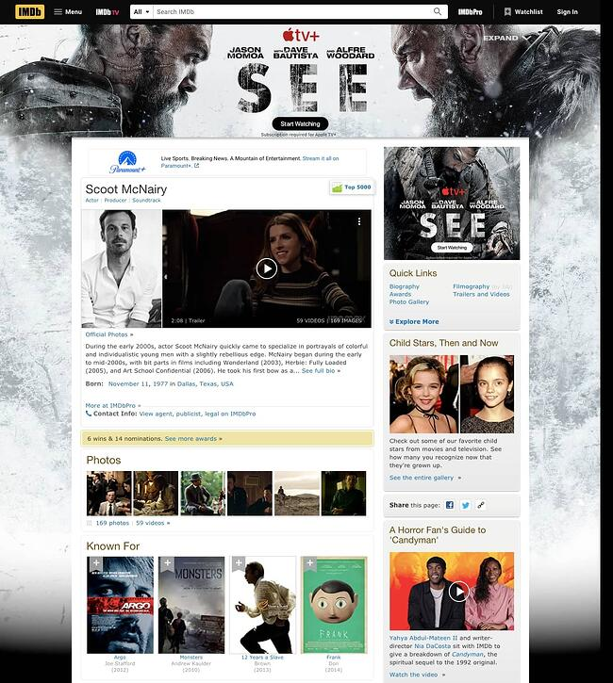
IMDb-Cluttered layout

Slide 12
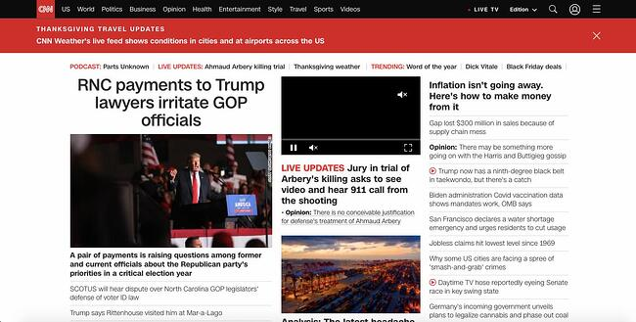
CNN - Slow load time

Slide 13
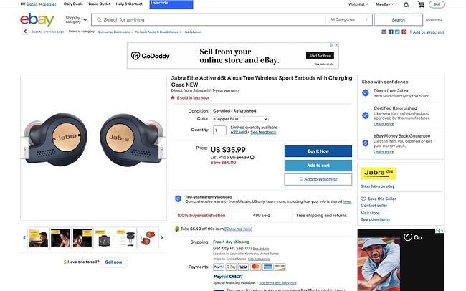
eBay-Complex product pages

Slide 14
What to design
Need to take into account:
Who the users are
What activities are being carried out
Where interaction is taking place
Need to optimize the interactions users have with a product:
So that they match the users’ activities and needs

Slide 15
What is user centered(interaction) design?
“Designing interactive products to support the way people communicate and interact in their everyday and working lives.”
Sharp, Rogers, and Preece (2019)
“The design of spaces for human communication and interaction.”
Winograd (1997)

Slide 16
Goals of interaction design
Develop usable products
Usability means easy to learn, effective to use, and provides an enjoyable experience
Involve users in the design process

Slide 17
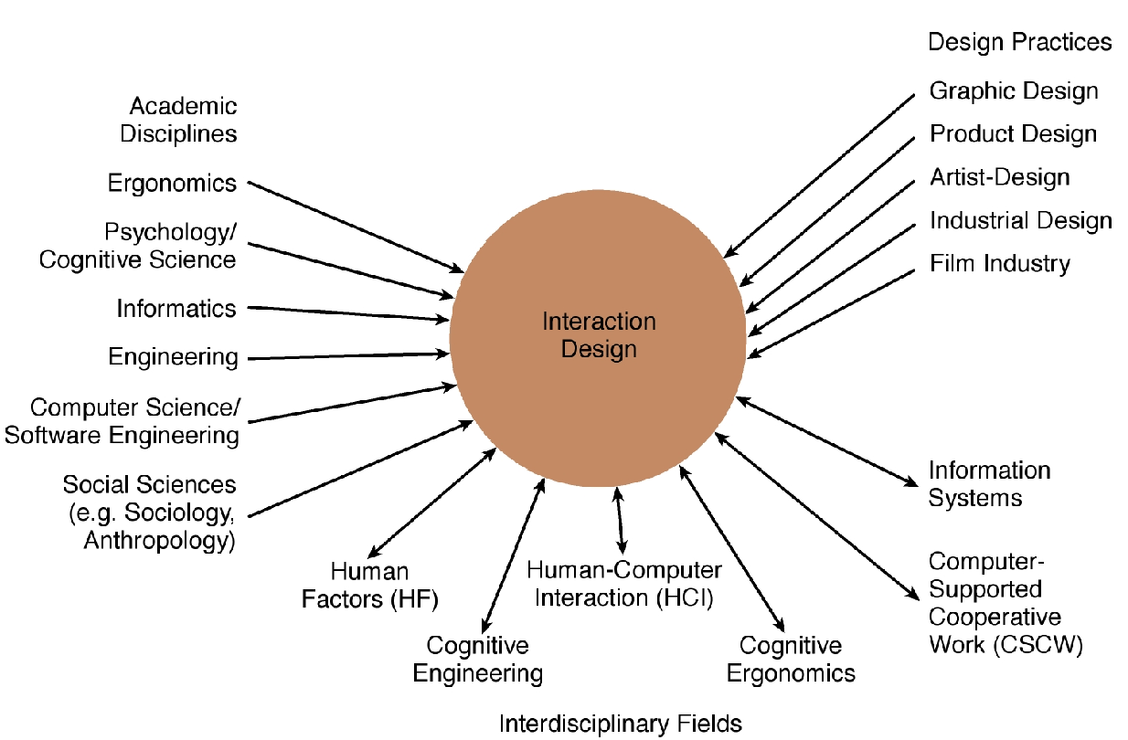
Interaction design

Slide 18
Interaction design in business
Large number of ID consultancies. Examples of well known ones include:
Nielsen Norman Group: “help companies enter the age of the consumer, designing human-centered products and services”
Cooper: “From research and product to goal-related design”
IDEO: “creates products, services and environments for companies pioneering new ways to provide value to their customers”

Slide 19
Usability goals
Effective to use
Efficient to use
Safe to use
Have good utility
Easy to learn
Easy to remember how to use

Slide 20
The user experience
How a product behaves and is used by people in the real world
The way people feel about it and their pleasure and satisfaction when using it, looking at it, holding it, and opening or closing it
“Every product that is used by someone has a user experience: newspapers, ketchup bottles, reclining armchairs, cardigan sweaters.” (Garrett, 2010)
“All aspects of the end-user's interaction with the company, its services, and its products. (Nielsen and Norman, 2014)
Cannot design a user experience−only can design for a user experience

Slide 21
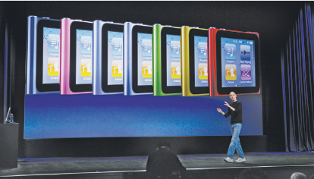
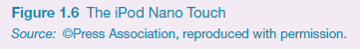
Why was the iPod user experience such a success?
Quality user experience from the start
Simple, elegant, distinct brand, pleasurable, must have fashion item, catchy names, cool...

Slide 22
Core characteristics of interaction design
Users should be involved throughout the development of the project
Specific usability and user experience goals need to be identified, clearly documented, and agreed to at the beginning of the project
Iteration is needed through the core activities

Slide 23
Why?
Help designers:
Understand how to design interactive products that fit with what people want, need, and may desire
Appreciate that one size does not fit all (for example, teenagers are very different to grown-ups)
Identify any incorrect assumptions they may have about particular user groups. (for example, not all old people want or need big fonts)
Be aware of both people’s sensitivities and their capabilities

Slide 24
Accessibility and inclusiveness
Accessibility: the extent to which an interactive product is accessible by group of people
Focus is on people with disabilities; for instance, those using apple voiceover(screen reader,spoken descriptions)
Inclusiveness: making products and services that accommodate the widest possible number of people
For example, smartphones designed for all and made available to everyone regardless of their disability, education, age, or income

Slide 25
Disability
Disabilities can be classified as:
Sensory impairment (such as loss of vision or hearing)
Physical impairment (having loss of functions to one or more parts of the body after a stroke or spinal cord injury)
Cognitive (including learning impairment or loss of memory/cognitive function due to old age)
Each type can be further defined in terms of capability:
For example, someone might have only peripheral vision, be color blind, or have no light perception

Slide 26
Cultural differences
5/21/2015 versus 21/5/2015?
Which should be used for international services and online forms?
Why is it that certain products, like smartphones, are universally accepted by people from all parts of the world, whereas people from different cultures react to websites differently?

Slide 27
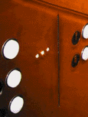
Visibility - poor interface
• This is a control panel for an elevator
• How does it work?
• Push a button for the floor you want?
• Nothing happens. Push any other button? Still nothing. What do you need to do?
It is not visible as to what to do!

Slide 28
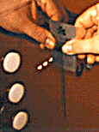
Visibility - Improving on a poor interface
…with this elevator, you need to insert your room card in the slot by the buttons to get the elevator to work!
How would you make this action more visible?
• Make the card reader more obvious
• Provide an auditory message that says what to do (which language?)
• Provide a big label next to the card reader that flashes when someone enters
• Make relevant parts visible
• Make what has to be done obvious

Slide 29
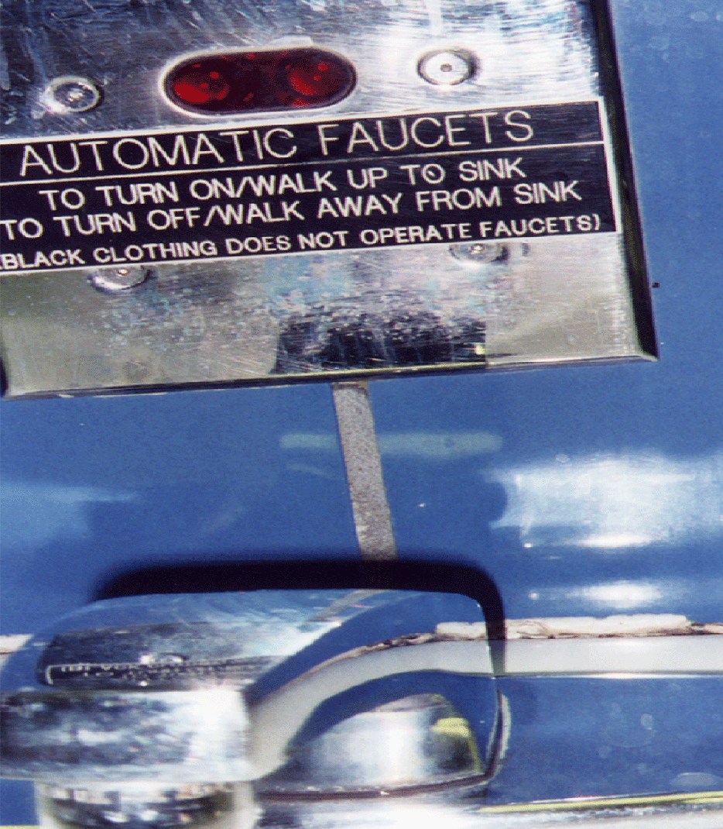
What do I do if I am wearing black?
Invisible automatic controls can make it more difficult to use

Slide 30
Feedback
Sending information back to the user about what has been done
Includes sound, highlighting, animation, and combinations of these
For example, when screen button is clicked, it provides sound or red highlight feedback:
“ccclichhk”

Slide 31
Feedback
When a user finally takes an action or interacts with our product, they often get an immediate reward of more content or a completed task.
A well designed user experience offers us feedback that keeps us reassured we are on track.
Digitally, feedback appears in the form of loading bars, error messages, vibrations, etc.

Slide 32
In a tangible example, if you’ve ever turned your car key in the ignition and heard the engine purr—that is great feedback, you know then to shift into drive.
Feedback is the error message you receive when you type in the wrong password; it’s the delightful pinging sound you hear when you’ve processed a payment in the app store.

Slide 33
Constraints
Restricting the possible actions that can be performed
Helps prevent user from selecting incorrect options

Slide 34
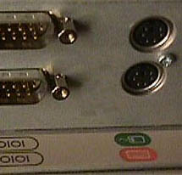
Logical or ambiguous design?
Where do you plug the mouse?
Where do you plug the keyboard, in the top or bottom connector?
Do the color-coded icons help?

Slide 35
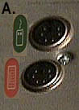
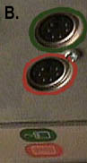
How to design them more logically
(A) provides direct adjacent mapping between icon and connector
(B) provides color coding that associates the connectors with the labels

Slide 36
Consistency
Design interfaces to have similar operations and use similar elements for similar tasks. (for example, always use Ctrl key plus first initial of the command for an operation: Ctrl+c, Ctrl+s, Ctrl+o)
The main benefit is that consistent interfaces are easier to learn and use

Slide 37
When consistency breaks down
What happens if there is more than one command starting with the same letter? (for example, save, spelling, select, style)
You have to find other initials or combinations of keys, thereby breaking the consistency rule (for example, Ctrl+s, Ctrl+shift+l)
Increases learning burden on user, making them more prone to errors

Slide 38
Internal and external consistency
Internal consistency refers to designing operations to behave the same within an application
(eg: your logo is the same online and in print)
External consistency refers to designing operations, interfaces, and so on to be the same across applications and devices
(eg: the user interface of Adobe products. Once you know Photoshop it is much easier to reuse the same knowledge to start using Illustrator and so on.)

Slide 39
Keypad numbers layout
A case of external inconsistency
(a) phones, remote controls
(b) calculators, computer keypads
1
2
3
7
8
9
4
5
6
4
5
6
7
8
9
1
2
3
0
0

Slide 40
Affordances: to give a clue
Refers to an attribute of an object that allows people to know how to use it. (For example, a mouse button invites pushing, a door handle affords pulling)
Norman (1988) used the term to discuss the design of everyday objects
Has since been popularized in interaction design to discuss how to design interface objects (for example, scrollbars to enable moving up and down; icons to click on)

Slide 41
What does “affordance” have to offer interaction design?
Interfaces are virtual and do not have affordances like physical objects
Norman argues that it does not make sense to talk about interfaces in terms of ‘real’ affordances
Instead, interfaces are better conceptualized as ‘perceived’ affordances:
Learned conventions of arbitrary mappings between action and effect at the interface

Slide 42
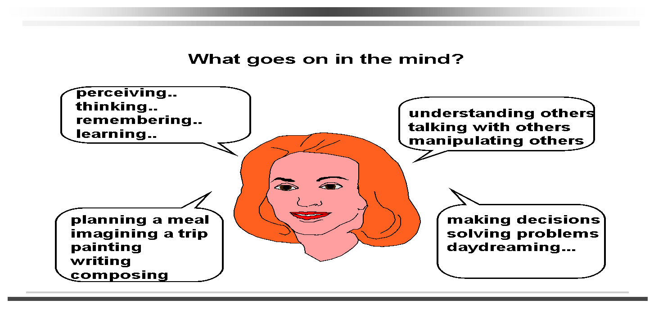
Bringing cognitive psychology knowledge to HCI

Slide 43
Core cognitive aspects
Attention
Perception and recognition
Memory
Reading, speaking and listening
Problem-solving, planning, reasoning and decision-making, learning
Here we focus on attention, perception & recognition, & memory

Slide 44
Attention
Selecting things to concentrate on from the mass around us, at a point in time
Information at the interface should be structured to capture users’ attention, e.g. use perceptual boundaries (windows), colour, sound and flashing lights

Slide 45
Design implications for attention
Make information salient when it needs attending to
Use techniques that make things stand out like colour, ordering, spacing, underlining, sequencing and animation
Avoid cluttering the interface - follow the google.com example of crisp, simple design
Avoid using too much because the software allows it

Slide 46
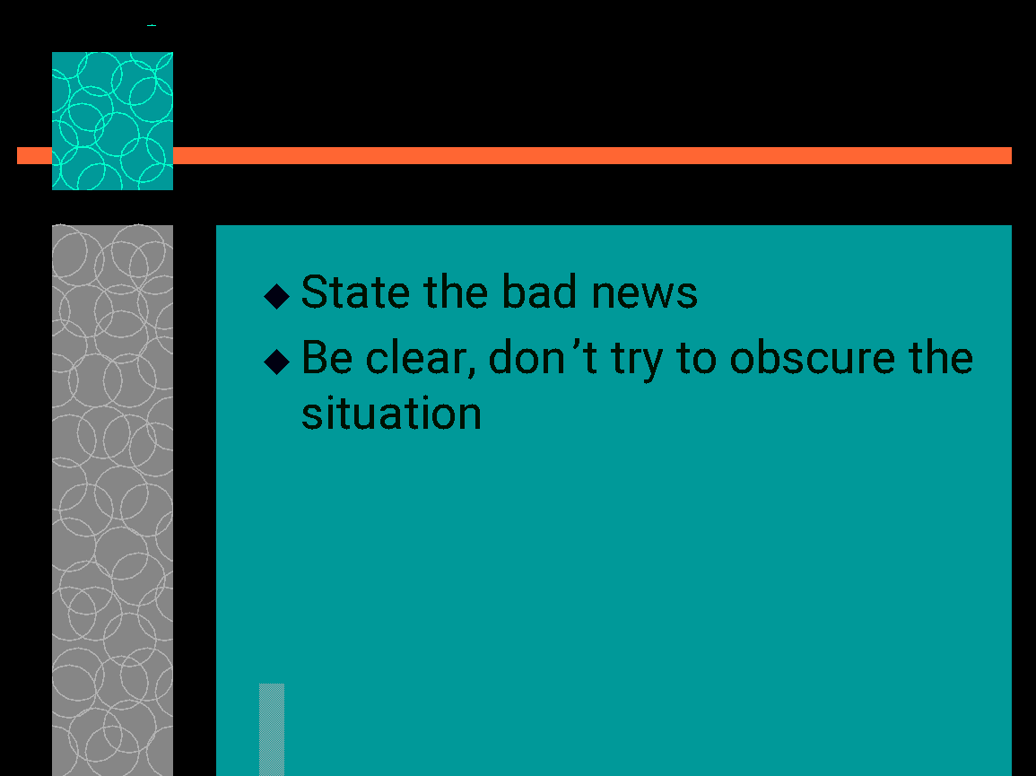
An example of over-use of graphics

Slide 47
Perception and recognition
How information is acquired from the world and transformed into experiences
Obvious implication is to design representations that are readily perceivable, e.g.
Text should be legible
Icons should be easy to distinguish and read

Slide 48

Which is easiest to read and why?
What is the time?
What is the time?
What is the time?
What is the time?
What is the time?

Slide 49
Memory
Involves encoding and recalling knowledge and acting appropriately
We don’t remember everything - involves filtering and processing
We recognize things much better than being able to recall things
The rise of the GUI over command-based interfaces
Better at remembering images than words
The use of icons rather than names

Slide 50
The problem with the classic ‘7±2’
George Miller’s theory of how much information people can remember
People’s immediate memory capacity is very limited
Many designers have been led to believe that this is useful finding for interaction design

Slide 51
What some designers get up to…
Present only 7 options on a menu
Display only 7 icons on a tool bar
Have no more than 7 bullets in a list
Place only 7 items on a pull down menu
Place only 7 tabs on the top of a website page
But this is wrong? Why?

Slide 52
Affordance, Signifier, Mapping and Feedback

Slide 53
Affordance
An affordance is the relationship between an object and the actions a person can take with that object.
For example, a button affords pressing, a door handle affords pulling or turning, and a smartphone screen affords all types of interactions like swiping, tapping, pinching, and scrolling.
Affordances rarely exist on their own. Meaning that a product or experience will have functionality built-in, but there are almost always clues designed to orient the user towards affordances.

Slide 54
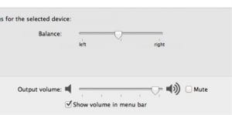
A good example of Affordance on a technological aspect is the volume slider on your computer.
Its simple, and easy to read and understand, explaining what it is doing while you are operating it.

Slide 55

Implicit Affordance

Slide 56
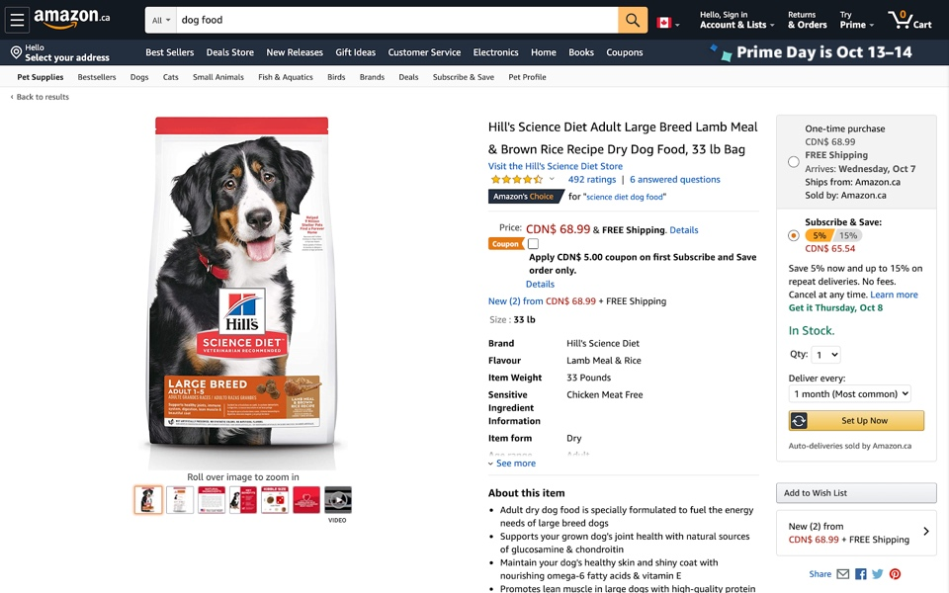
Explicit Affordance

Slide 57
Signifiers
Once you’ve bestowed your product with affordances, you must then decide how you can give subtle but intuitive clues to your user about how to interact with them. These clues are called signifiers.
These can be any kind of perceptible information that signals your user to act in a desired way.
Signifiers can be explicit textual information, sound, texture, lighting, color, symbols, or even proximity of objects to one another.
With smartphones and laptops, for example, we rely on cues like shading, color, text, sounds, and haptics(touch and motion).

Slide 58
“Signifiers” can be used to just mean component labels, but in more complex discussions or within design systems, signifiers can also be:
The colour of the component when aligned to accepted digital design patterns
Text labels on or near a component
Icon labels on or near a component
The emphasis of any text (bold, italic, underline)

Slide 59
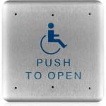
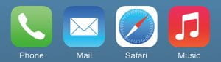
Good examples of signifiers

Slide 60
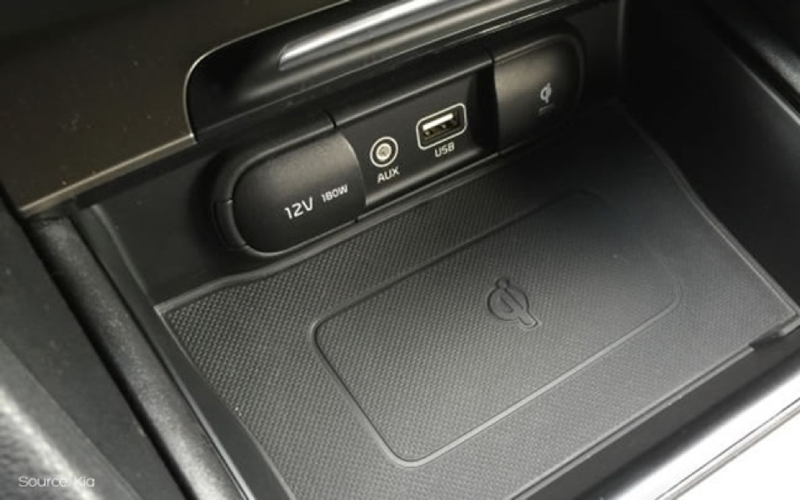

Slide 61
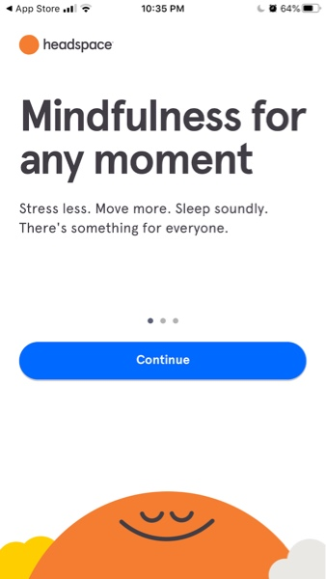

Slide 62
Affordances and signifiers together
Through UX and UI design of an interface, we can layer signifiers onto an affordance to communicate:
a) What the thing can do (affordance)
b) Its current state or significance (signifier)

Slide 63
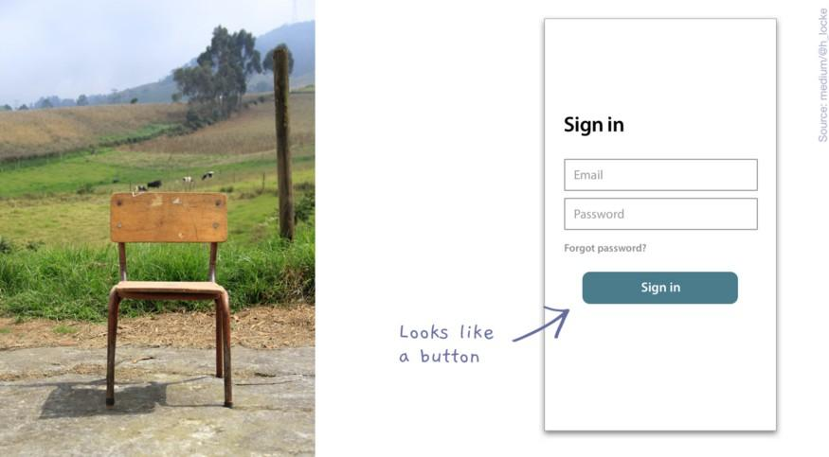
Example: Perceiving a chair, the structure, plains and stability, we know it can be sat or stood on. Example: Perceiving a button on a screen, we know it is something that can be pressed to produce an action.
Example: Perceiving a chair, the structure, plains and stability, we know it can be sat or stood on.
Example: Perceiving a button on a screen, we know it is something that can be pressed to produce an action.

Slide 64
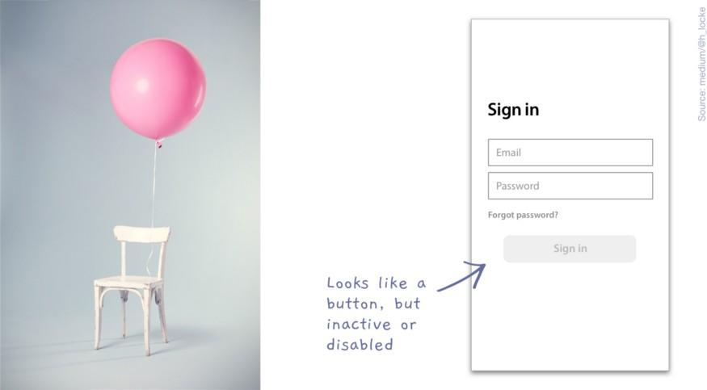
Example: The chair has a balloon tied to it, implying that it is reserved for some special occasion. Example: The button is greyed out, suggesting it is inactive.
Example: The chair has a balloon tied to it, implying that it is reserved for some special occasion.
Example: The button is greyed out, suggesting it is inactive.

Slide 65
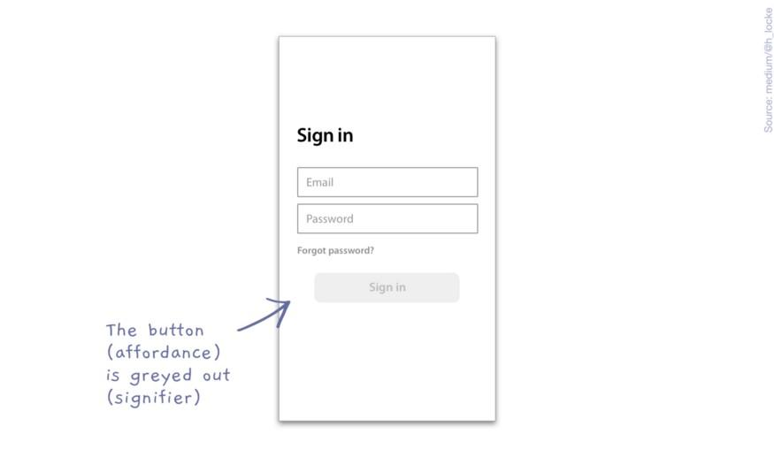
Example: The button (affordance) is greyed out (signifier)

Slide 66
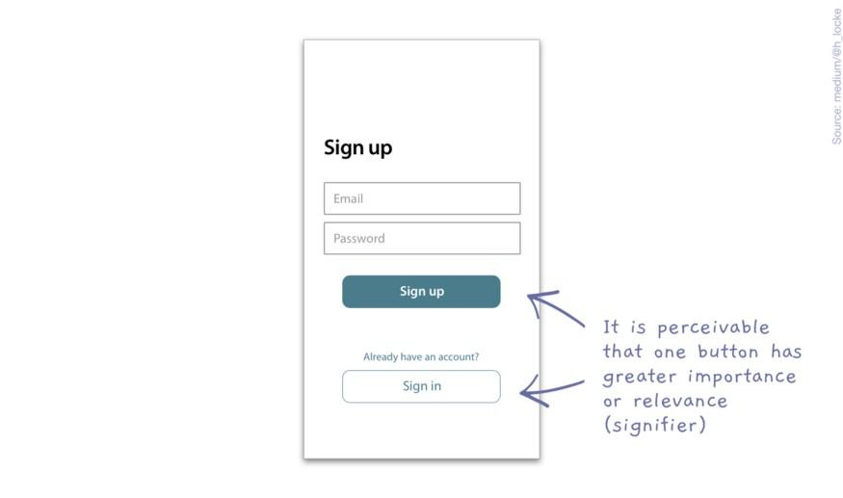
Example: There are two buttons (affordance) and it is perceivable that one is probably the preferred action (signifier)

Slide 67
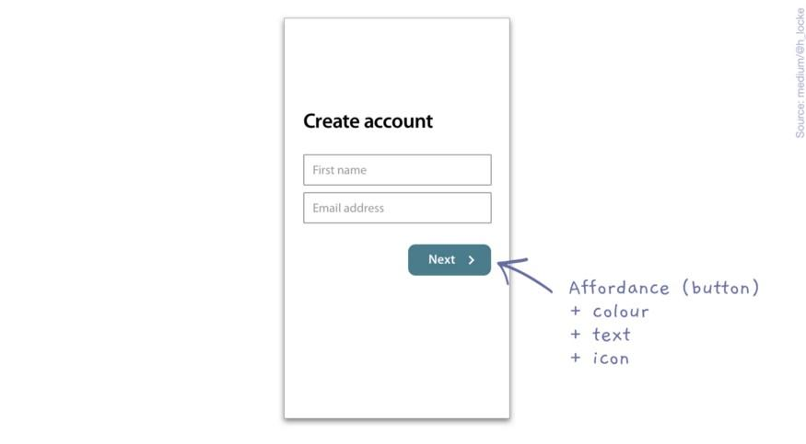
Example: A button (affordance) which uses the interface’s primary action style (colour signifier) which describes the action (word signifier) which includes a forward arrow (directional signifier).

Slide 68
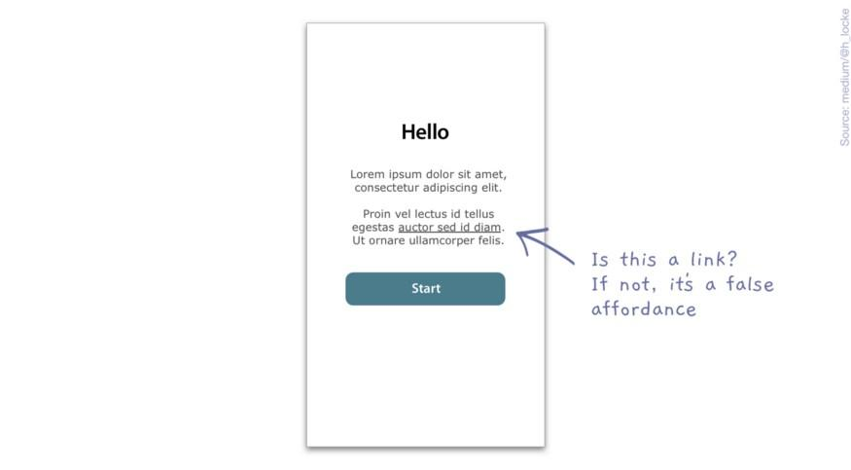
False affordance
The thing looks like it can do something, but it can’t.

Slide 69
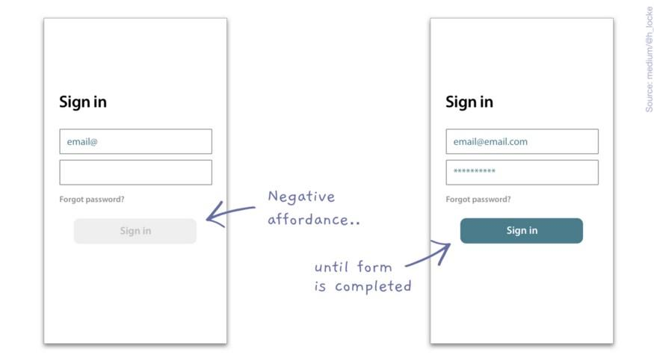
Negative affordance
There is an affordance such as a button, but it is not active.
It looks like a button, it is a button, but it doesn’t behave like a button.
This is ok if it’s a temporarily disabled button, which becomes active when the user completes a form, but not if it’s just a button on a screen doing nothing.

Slide 70
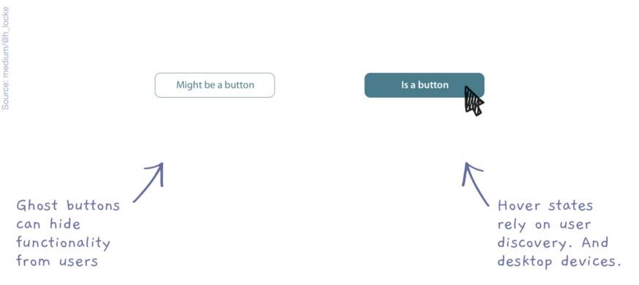
Hidden affordance
The thing is not perceivable or available until the user interacts with it.
A classic example is the ghost button, which I see missed all the time by users. Almost invisible until you serendipitously stumble upon it or hover over it and then you can use the interface.

Slide 71
Feedback
When a user finally takes an action or interacts with our product, they often get an immediate reward of more content or a completed task.
A well designed user experience offers us feedback that keeps us reassured we are on track.
Digitally, feedback appears in the form of loading bars, error messages, vibrations, etc.

Slide 72
In a tangible example, if you’ve ever turned your car key in the ignition and heard the engine purr—that is great feedback, you know then to shift into drive.
Feedback is the error message you receive when you type in the wrong password; it’s the delightful pinging sound you hear when you’ve processed a payment in the app store.

Slide 73
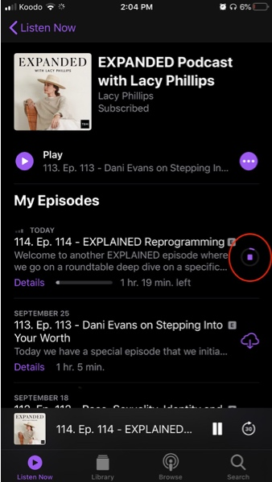
Feedback reassures us that we are making progress.
For example, when downloading a podcast, if you didn’t see any type of loading bar you might assume that the content isn’t yours yet or that the app doesn’t allow downloading.

Slide 74
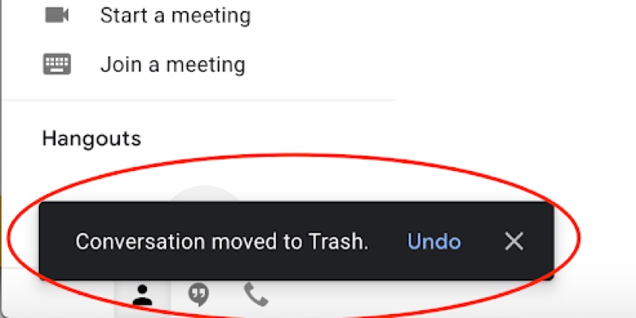

Slide 75
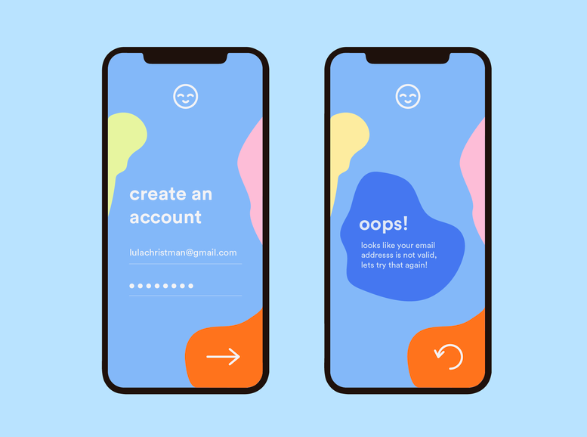

Slide 76
Visibility
Visibility is the basic principle that the more visible an element is, the more likely users will know about them and how to use them.
Equally important is the opposite: when something is out of sight, it’s difficult to know about and use.
The skill in applying this principle is realizing that you can’t make everything visible, because it’ll ultimately clutter the interface but instead need to prioritize what interface elements are by far the most important for the user experience and prioritize their visibility.

Slide 77
The trade-off between hamburger side-bar menus and tab-bar menus in mobile applications is a very recent design debate centered around this very principle of visibility.
While the hamburger menu provides a convenient place to store a variety of menu items in a mobile app, it comes at a huge disadvantage: the lack of visibility of the contained menu items.
We’ve seen a shift in major apps like Facebook away from hamburger menus and back toward tab-bar menus to improve the visibility of their key experiences.

Slide 78
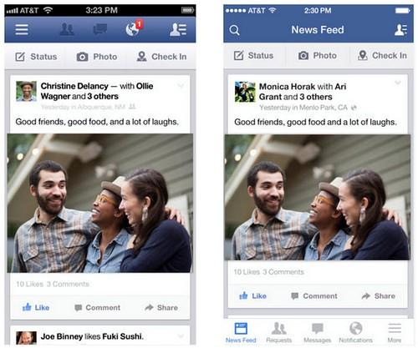

Slide 79
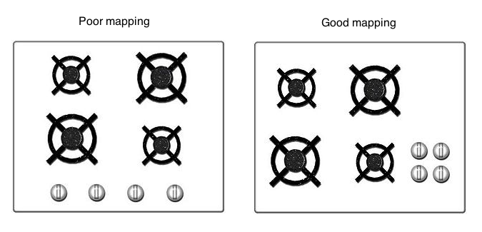
Mapping
Mapping is about having a clear relationship between controls and the effect they have on the world.
Mapping should be as natural as possible.
Stove tops are a great example . When you see the first image, the mapping is not very clear because it’s difficult to determine which control operates each burner. Versus the second image, it’s far clearer the control that controls each burner, which has a better mapping.

Slide 80
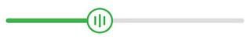
This slider also has a strong mapping, since it’s clear moving it to the right will increase it’s value versus moving it to the left will decrease it.

Slide 81
ERGONOMICS
Ergonomics is about ensuring a good fit between people and the things they interact with.
Ergonomics should be considered in the design of every product, system or environment.
Ergonomists can help you to identify which user characteristics you should take into account during your design process.
As ergonomists, our goal is to influence the design of man-machine systems so that human capabilities and limitations are considered from the early stages of the design process, and are accounted for in the final design.
Knowledge and experience, show that a design that considers such issues will result in an optimal system that enhances productivity, safety and job satisfaction.

Slide 82
Soft ergonomics is the study of designing virtual interfaces that cater towards the wellness of the human body, its emotional and cognitive abilities.
Soft ergonomics can be defined as the ability of any virtual interface(computer application, website, ATM options, parking meter etc.) to make it comfortable for the user to use the interface while working on the user's request.
It tries to find a compromise between user expectations, system workflow and aesthetics.
Users from various cultural and technological background are exposed to a common interface. The interface developer seeks to ensure that the interface does not harm the user psychologically, physiologically or emotionally.

Slide 83
Soft ergonomics generally takes into account the following human factors when building a virtual interface:
1. Physical Limitations:
Not all who use a virtual interface are physically equal.
If the designed interface only caters to right-handed individuals, or people within a certain height range, then the interface might need a redesign.
One of the leading discussion is with respect to visually impaired users.
2. Emotional Needs:
The interface should be 'designed for the occasion' or context.
It should not leave the user confused, either by how to start using the interface or what to do when an error occurs.
Confusion leads to frustration, which eventually builds stress in the body causing long term emotional damage.

Slide 84
3. Cognitive Abilities:
If the product (e.g. software application, website) is designed for any casual user, then the designer should not expect that all users will be experts with high cognitive abilities.
The usage of the application should not need the user to know a lot of information prior to using the interface.
For example, using an automated teller machine can require memorizing a pin number but not the account number.

Slide 85
Criteria for Soft Ergonomics
The following lists (non-exhaustive) some of the most common criteria for evaluating soft ergonomics.
Consistency:
The design should be consistent across the entire application.
Consistent sequence of actions, identical terminologies and platform conventions should be followed throughout the application.
Efficiency:
The virtual interface should allow efficient use of user's time. The screens should load and display content within acceptable amount of time.
The more than expected time a user has to wait, more stress is built into the human body causing long term damage.
The interface should also have functionality for advanced users. While being non-obtrusive to novice users, accelerators or shortcuts should be available for experienced users.

Slide 86
Design:
The system should preferably have minimalistic and aesthetically pleasing design.
Minimalistic design help user easily consume the data and hence there is less stress on the human mind and aesthetically pleasing design increases the 'feel good' factor in the user.
Memory:
User's memory load should be minimized.
All information that a user needs from the application to perform a task should be presented or easily retrievable by the user.
Context Help:
The 'Help' menu and options that give context help should be always available to the user.

Slide 87
UCD Principles
From Jeffrey Rubin, Handbook of Usability Testing:
Early focus on users and tasks
Structured and systematic information gathering
Designers trained by experts before conducting data collection sessions
Empirical Measurement and testing of product usage
Focus on ease of learning and ease of use
Testing of prototypes with actual users
Iterative Design
Product designed, modified and tested repeatedly.
Allow for the complete overhaul and rethinking of design by early testing of conceptual models and design ideas.

Slide 88
User-Centered Design Process
Design is based upon an explicit understanding of users, tasks, and environments; is driven and refined by user-centered evaluation; and addresses the whole user experience.
The process involves users throughout the design and development process and it is iterative.

Slide 89
Phases of the UCD process:
The following are the general phases of the UCD process:
Specify the context of use: Identify the people who will use the product, what they will use it for, and under what conditions they will use it.
Specify requirements: Identify any business requirements or user goals that must be met for the product to be successful.
Create design solutions: This part of the process may be done in stages, building from a rough concept to a complete design.
Evaluate designs: Evaluation - ideally through usability testing with actual users - is as integral as quality testing is to good software development.

Slide 90
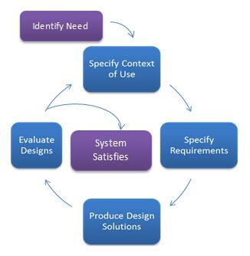

Slide 91
6 Laws that Help You Create a Better Design
A common goal of every product — to make the users’ life easier.
Some famous principles from psychology, philosophy and economics that you can apply to your design.
Hick’s Law
Jakob’s Law
Ockham’s Razor Law
Fitt’s Law
Weber’s Law
Pareto’s Law
Apart from the basic design principles, there are other rules or laws that you can follow to make your design stand out like the golden rules.

Slide 92
Fitts’ Law: Make it simple, but significant
Fitts’s law is a predictive model of human movement developed by Paul Fitts, an American psychologist.
Fitts’ law states that the amount of time required for a person to move a pointer (e.g., mouse cursor) to a target area is a function of the distance to the target divided by the size of the target.
Thus, the longer the distance and the smaller the target’s size, the longer it takes.
By his law, fast movements and small targets result in greater error rates, due to the speed-accuracy trade-off.

Slide 93
Fitts’ law is widely applied in user experience (UX) and user interface (UI) design.
For example, this law influenced the convention of making interactive buttons large (especially on finger-operated mobile devices)—smaller buttons are more difficult (and time-consuming) to click.
Likewise, the distance between a user’s task/attention area and the task-related button should be kept as short as possible.

Slide 94
When it is used in a design, it means that your buttons should be large, obvious and the distance between one action to the next should be minimised.
Pop-up menus better support immediate selection of interactive elements than dropdown menus as the user does not have to move the cursor from its current position.

Slide 95
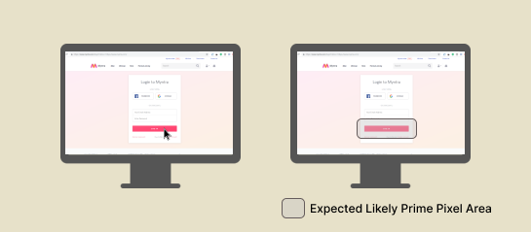

Slide 96
Hick’s Law: More options, more problems
Hick’s law, a psychology principle that is named after two psychologists, William Edmund Hick and Ray Hyman, states that the more options available for the users, the longer time it will take for them to make a decision.
Delivering a good user experience requires that first you find out the functionalities that will answer users needs; second, you need to guide them to the specific functions they need most.
If users end up stuck in the decision-making process of “what next?”, they may become confused, frustrated, or leave your website.

Slide 97
Hick’s Law is a simple idea that says that the more choices you present your users with, the longer it will take them to reach a decision.
Users bombarded with choices have to take time to interpret and decide, giving them work they don’t want.
When there are lots of options available, your users would need to learn, consider and weigh all the options before making up their mind. That means it takes a longer time to reach their goal.
Apart from this, more options could mean more problems, especially if there is no clear explanation for each option.

Slide 98
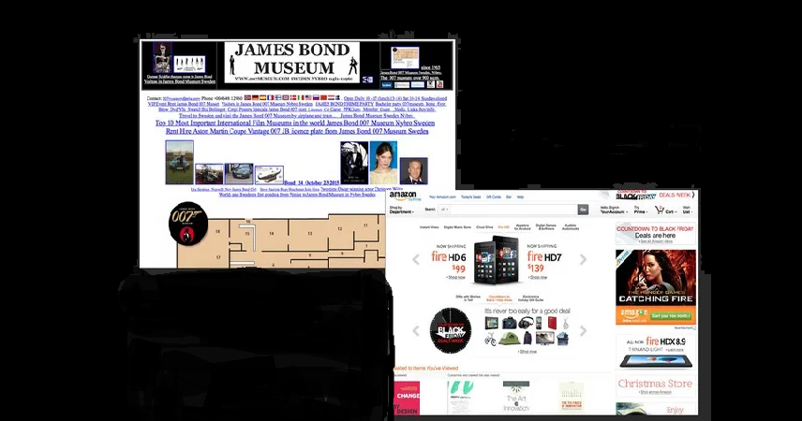
You can see Hick’s Law in action in the navigation of almost any website.

Slide 99
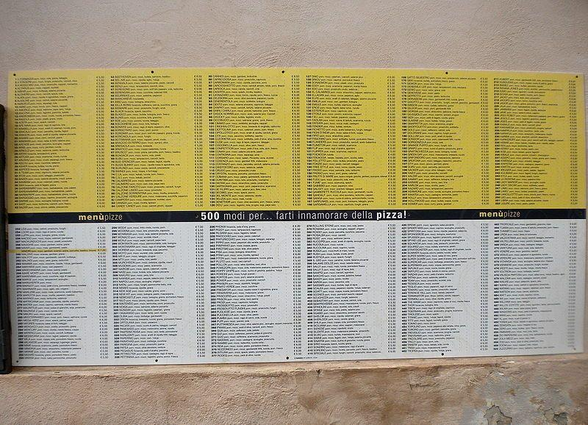
Follows Hicks law or not?

Slide 100
Weber’s Law: Just Noticeable Difference
Weber’s law is named after a German physician, Ernst Heinrich Weber, also called Weber-Fechner law, historically important psychological law quantifying the perception of change in a given stimulus.
The law states that the change in a stimulus that will be just noticeable is a constant ratio of the original stimulus.
A stimulus is anything that causes a reaction in an organism.
Perception is what happens when an organism takes in a stimulus and makes meaning of it.
Weber's law is an essential concept because it helps understand how people perceive different stimuli.
The law reveals that perception of stimuli is relative, not absolute.

Slide 101
Weber’s Law can be used for various sensory modalities in GUIs such as brightness, loudness, line length, visual weight of fonts in typography, color matching etc.
Many times large amount of information is required to be displayed on a limited size computer screen and in various forms viz. text, pictures, drawings, maps, graphs, videos etc.
Poor visual design of user interface lacks the ability of differentiating between two close enough visual stimuli e.g. two lines with different thicknesses in a map (for wide roads and narrow lanes).What is this threshold of line thickness that may lead to noticeable difference is governed by Weber’s law.
The threshold of noticeable difference between color shades is also governed by Weber’s law.

Slide 102
The law explains that the perceived change in stimuli is proportional to the original stimuli, together with the just noticeable difference, it means that the size of the just noticeable difference (the slightest change in stimuli that can be observed or noticed) is in proportion to the original stimuli.
When we redesign a product, we should think about how the users adapt to the changes. Usually, if your product has a drastic change, no matter how good the new design is, the users would still think the old one is better. This is a natural human behaviour.
What you should do instead is — change gradually, so gradually that the users could not see a significant difference. This helps them adapt to and accept the new design.

Slide 103
Jakob’s law
Jakob’s law was invented by Jakob Neilsen, a user advocate.
This law states that asking users to adopt new behaviours or even modify their existing behaviours is very, very hard.
Your users prefer your website to work in the same way as other websites.
For instance, if your website has lots of content, there should be a search function, your website footer should contain links to important pages, your website logo should be clickable and linked to the homepage.
Users do not like surprises, they prefer something that is familiar so they wouldn’t need to learn how to use your website.

Slide 104
Ochkam’s Razor Law
Ochkam’s Razor is a philosophy principle by William of Ockham, a Franciscan friar in the 14th century which believes that “Simplicity is the ultimate sophistication”.
There are different variations of this principle but it is roughly about when there are multiple solutions to a problem, the simplest one tends to be the best one.
When designing a product or a website, try to get rid of the unnecessaries as they create clusters and distraction. These make it difficult for your users to reach their goal.

Slide 105
Pareto Principle
Pareto Principle, as known as 80/20 rule, is named after an Italian economist Vilfredo Pareto.
This principle says that 80% of the outcome come from 20% of the cause.
When this is used in product design, it means that the unused functions or features could be removed due to the fact that they do not contribute to the outcome.
Get rid of everything that is not essential to making a point.

Slide 106
Chapter Ends

